Slide 1
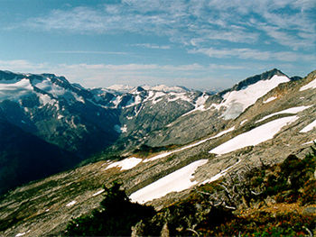
Tundra Biome
Students Name
Hira Khan
Javeria Ashraf
Maham Ahsan
Maryam Azhar

Slide 2
Introduction
The word tundra is derived from a Finnish word “tunturi” which means “ a treeless plain”.
The Tundra biome is the coldest of all five world biomes.
Tundra’s cover about one-fifth of Earth's land surface.
There is very low diversity.
The vegetation structure is simple
The nutrient and energy here is in the form of dead and organic material.

Slide 3
Types of Tundra
The Arctic Tundra
In the Arctic soil is always frozen, so large pools of water form on top of the ground. Arctic Tundra’s are found in the Northern Hemisphere.
The Alpine Tundra
Even though temperatures can drop to freezing in an Alpine Tundra, the soil is still able to drain water. Alpine Tundra’s are found on mountains all over the world at such a high altitude that trees cannot grow.

Slide 4
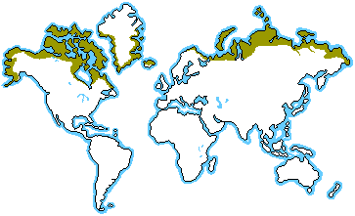
Location
The Tundra is located in; Greenland, Alaska, Northern Canada, Northern Scandinavia, Northern Siberia and Russia.
Near the North pole between 60⁰ and 75⁰ latitude.

Slide 5
Limiting Factors
Temperature of Tundra
The winters are extremely cold with temperature below -34°C. The summers last only about two months and the temperatures are still very cold ranging from 3° to 12° C. Average summer temperatures range from 37° to 60°F (3° to 16°C).
Soil in Tundra
Inactive layer ( permafrost)
If the permafrost melts, it alter the temperature and topography of a region, which threaten the existence of many species living in the tundra.
Active layer ( top of the permafrost)
Thaws in the summer months which allow vegetation to grow and enables the chemical processes necessary for sustaining life to occur.

Slide 6
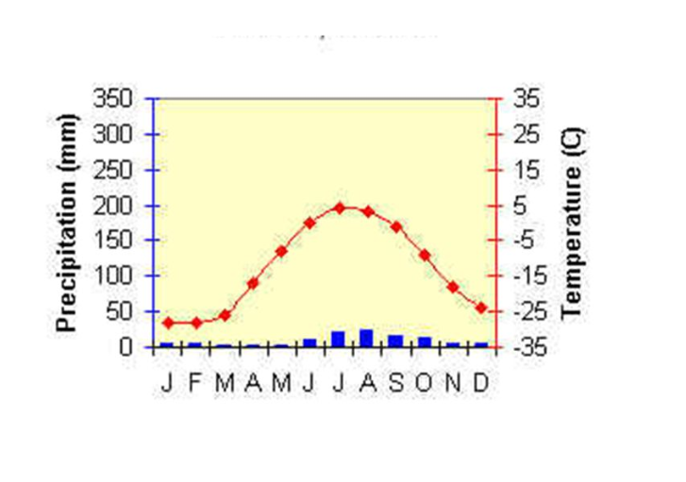
Rainfall
The Tundra receive approximately 6-10 inches precipitation per year. It is one of the lowest rainfall in the ecosystems.

Slide 7
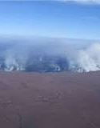
Fire in Tundra
Tundra fires have become more common over the past two decades as average temperatures in the Arctic have risen and sea ice has receded.
Warmer temperatures may allow more vegetation to grow — which, in turn, makes it more of a fire risk when lightning strikes.

Slide 8
Tundra Climate
The Tundra climate is a transitional climate between the Subarctic and Ice cap climates. It is a region of rolling to nearly level terrain almost entirely devoid of trees. Polar climates like the tundra are characterized by very cold temperatures and generally dry conditions. Temperatures never rise above 10º C (50ºF) during the summer. The tundra located near the Arctic and Antarctic Circle, experiences times when the Sun never rises above the horizon.

Slide 9
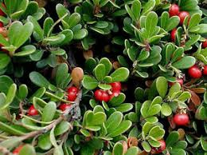
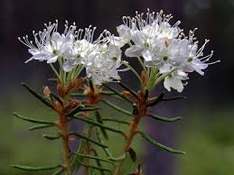
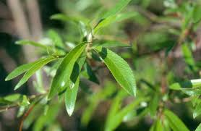
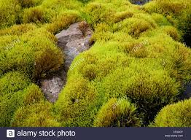
List of Flora present in Tundra region:
Sr # | Name of flora | Images
1. | Bearberry
2. | Labrador tea
3. | Diamond leaf
4. | Arctic moss

Slide 10
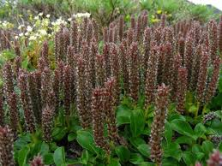
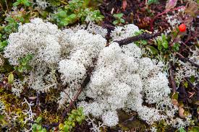
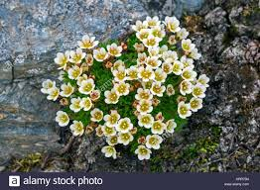
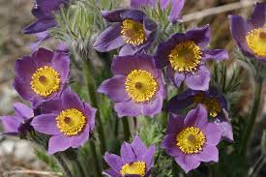
5. | Arctic willow
6. | Caribou moss
7. | Tufted Saxifrage
8. | Pasque flower

Slide 11
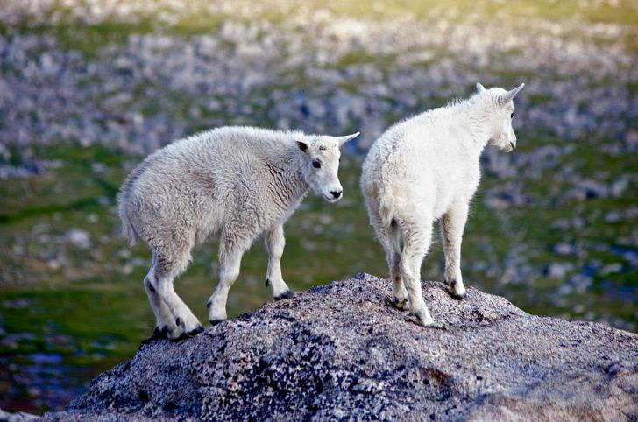
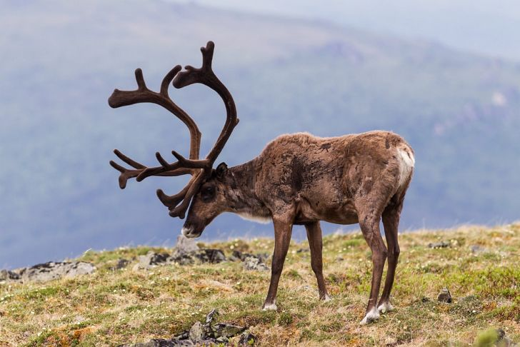
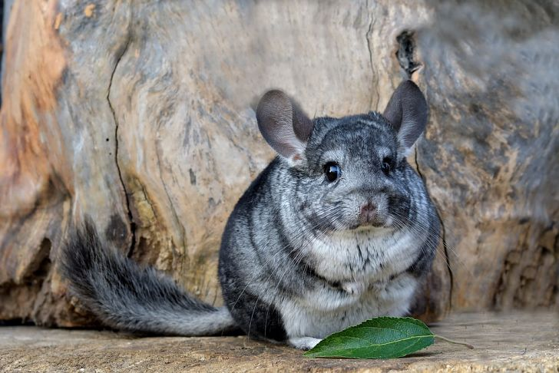
List of Fauna in Tundra region:
Sr # | Fauna Names | Images
1. | Mountain goat
2. | Caribou
3. | Chinchillas

Slide 12
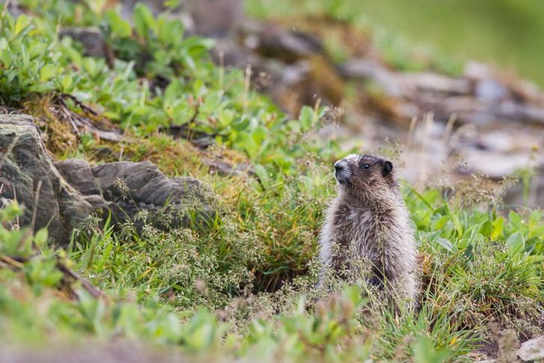
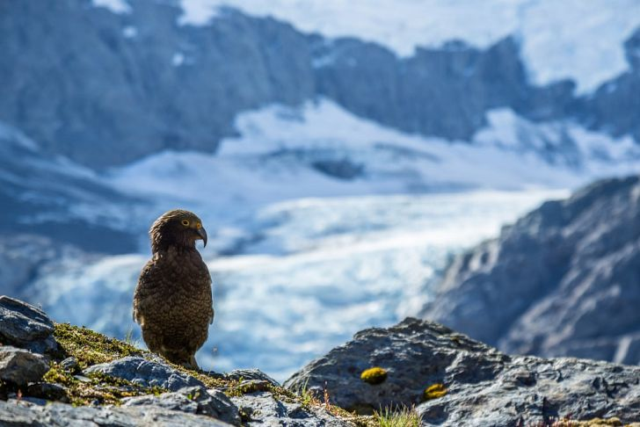
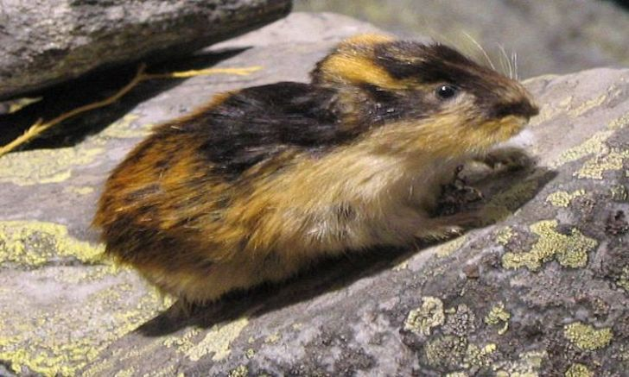
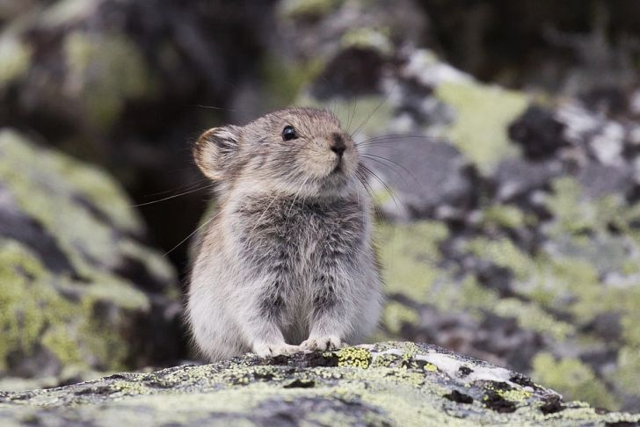
4. | Marmot
5. | Kea
6. | Lemming
7. | Pika

Slide 13
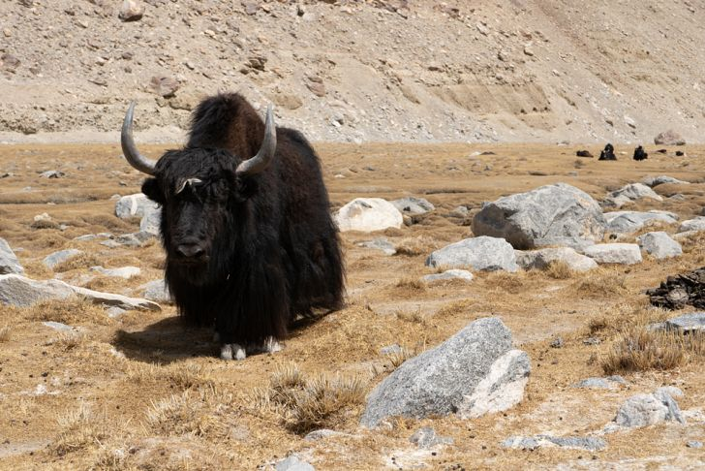
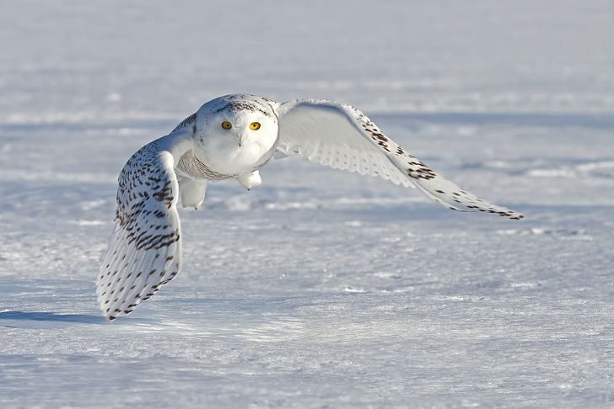
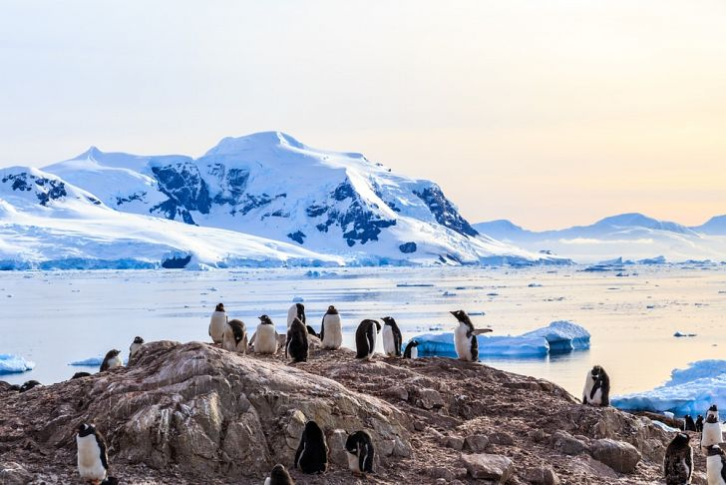
8. | Yak
9. | Snowy Owl
10. | Antarctic Penguins

Slide 14
Human Impacts
Hunting
Native people lived in world’s tundra for thousands of years. They practice a primitive form of survival by hunting for all of their food including birds, seals, walrus and whales.
Over Development
Construction of residences and other structures, as well as through the development of ski resorts, mines, and roads.
Oil drilling
Mining and oil drilling take the land away from the animals in the tundra because of the noise the machines make.
Global warming
Increased shrub growth, driven by recent and future warming in the arctic, could cause more warming in tundra ecosystems and for the planet as a whole. Taller shrubs prevent the snow from reflecting heat from the sun back into space, warming earth surface.
Air Pollution
Toxic mercury sent into the atmosphere by coal burning and industrial activity, is accumulating in Arctic Tundra, threating both humans and animals who live in the region.

Slide 15
Conclusion
The Tundra is a very unique biome. Tundra contributes to global biodiversity in a unique way. It is known for its genetic biodiversity. Many plants and animals have adaptations to survive in the harsh cold environment. It is essential that we protect this biome, not only because of the unique species of plants and animals, but also because of the greenhouse gases. Scientists have widely believed that the tundra always soaked up more carbon dioxide than it emitted.

